Slide 1
drought prediction for Northern Great Plains streams
Charles Jason Tinant
Oglala Lakota College
SDSM&T Civil Engineering Department

Slide 2

“ Climb Mount Fuji
O snail,
But, slowly, slowly.”
Kobayashi Issa

Slide 3
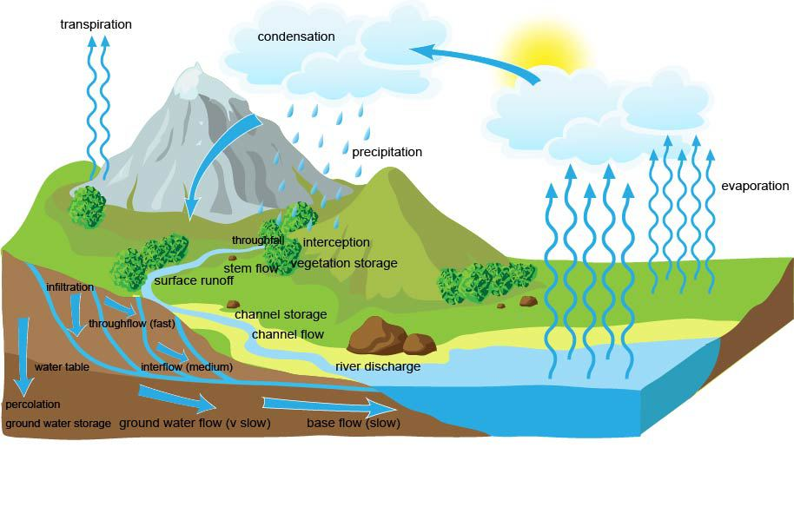

Droughts are natural hazards
Droughts are temporary water deficiencies determined relative to prevailing normal local conditions.
Meteorological drought: precipitation deficit that leads to:
Agricultural drought: inadequate soil moisture to meet evapotranspiration & vegetation demands that leads to:
Hydrological drought: surface & ground water deficit that recovers after precipitation and soil moisture returns to normal conditions
Generalized watershed hydrology
Source: www.alevelgeography.com

Slide 4
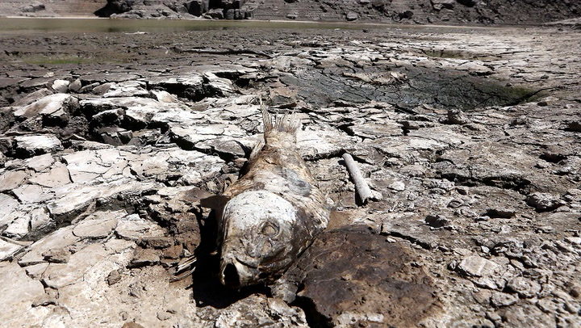
Affecting human and ecological communities
Drought results in stakeholder conflicts
Socioeconomic drought: water demand exceeds water supply—
Caused by growing human populations, economic development,
Leading to over-allocation, competing beneficial uses & non-sustainable groundwater use
Ecological drought: ecosystem stress & adversity to plants and animals—
Caused by flow reduction, higher water temps & salinity;
Resulting from hydrologic drought, undervaluation of ecosystem services & non-sustainable groundwater use
Extreme drought in South Africa, 2017-18
https://www.timeslive.co.za/news/south-africa/2017-11-16-sa-still-plagued-by-drought/

Slide 5
indices Can Help to Understand & Communicate Drought
Drought indices relate dry and wet periods to their frequency and duration
Standardized Precipitation Index (SPI) for meteorological drought
Standardized Precipitation Evapotranspiration Index (SPEI) for soil moisture drought—“climate water balance”
Streamflow drought index (SDI) for hydrological drought
Generalized Calculation Approach
Sum daily hydrologic time-series observations by month
Calculate probability-weighted moments (PWMs) from the monthly time-series,
Fit a distribution using the PWMs
SPI - Pearson III distribution
SPEI- Log-logistic distribution
SDI - Log-Pearson III distribution

Slide 6
Drought is Complex & poorly understood
Most small watersheds are ungauged with no available information ¹
We lack understanding of:
processes & feedbacks at the watershed-scale,
how heterogeneity of scale, time and space affects processes ¹
“We understand how freshwater communities persist during normal and high flows better than we understand the ecological effects of droughts” ²
We should improve information transfer approaches (downscaling) from gauged to ungauged watersheds ¹
A decade of Predictions in Ungauged Basins (PUB)—a review (Hrachowitz et al. 2014)
PS Lake - Drought and Aquatic Ecosystems: Effects and Responses

Slide 7
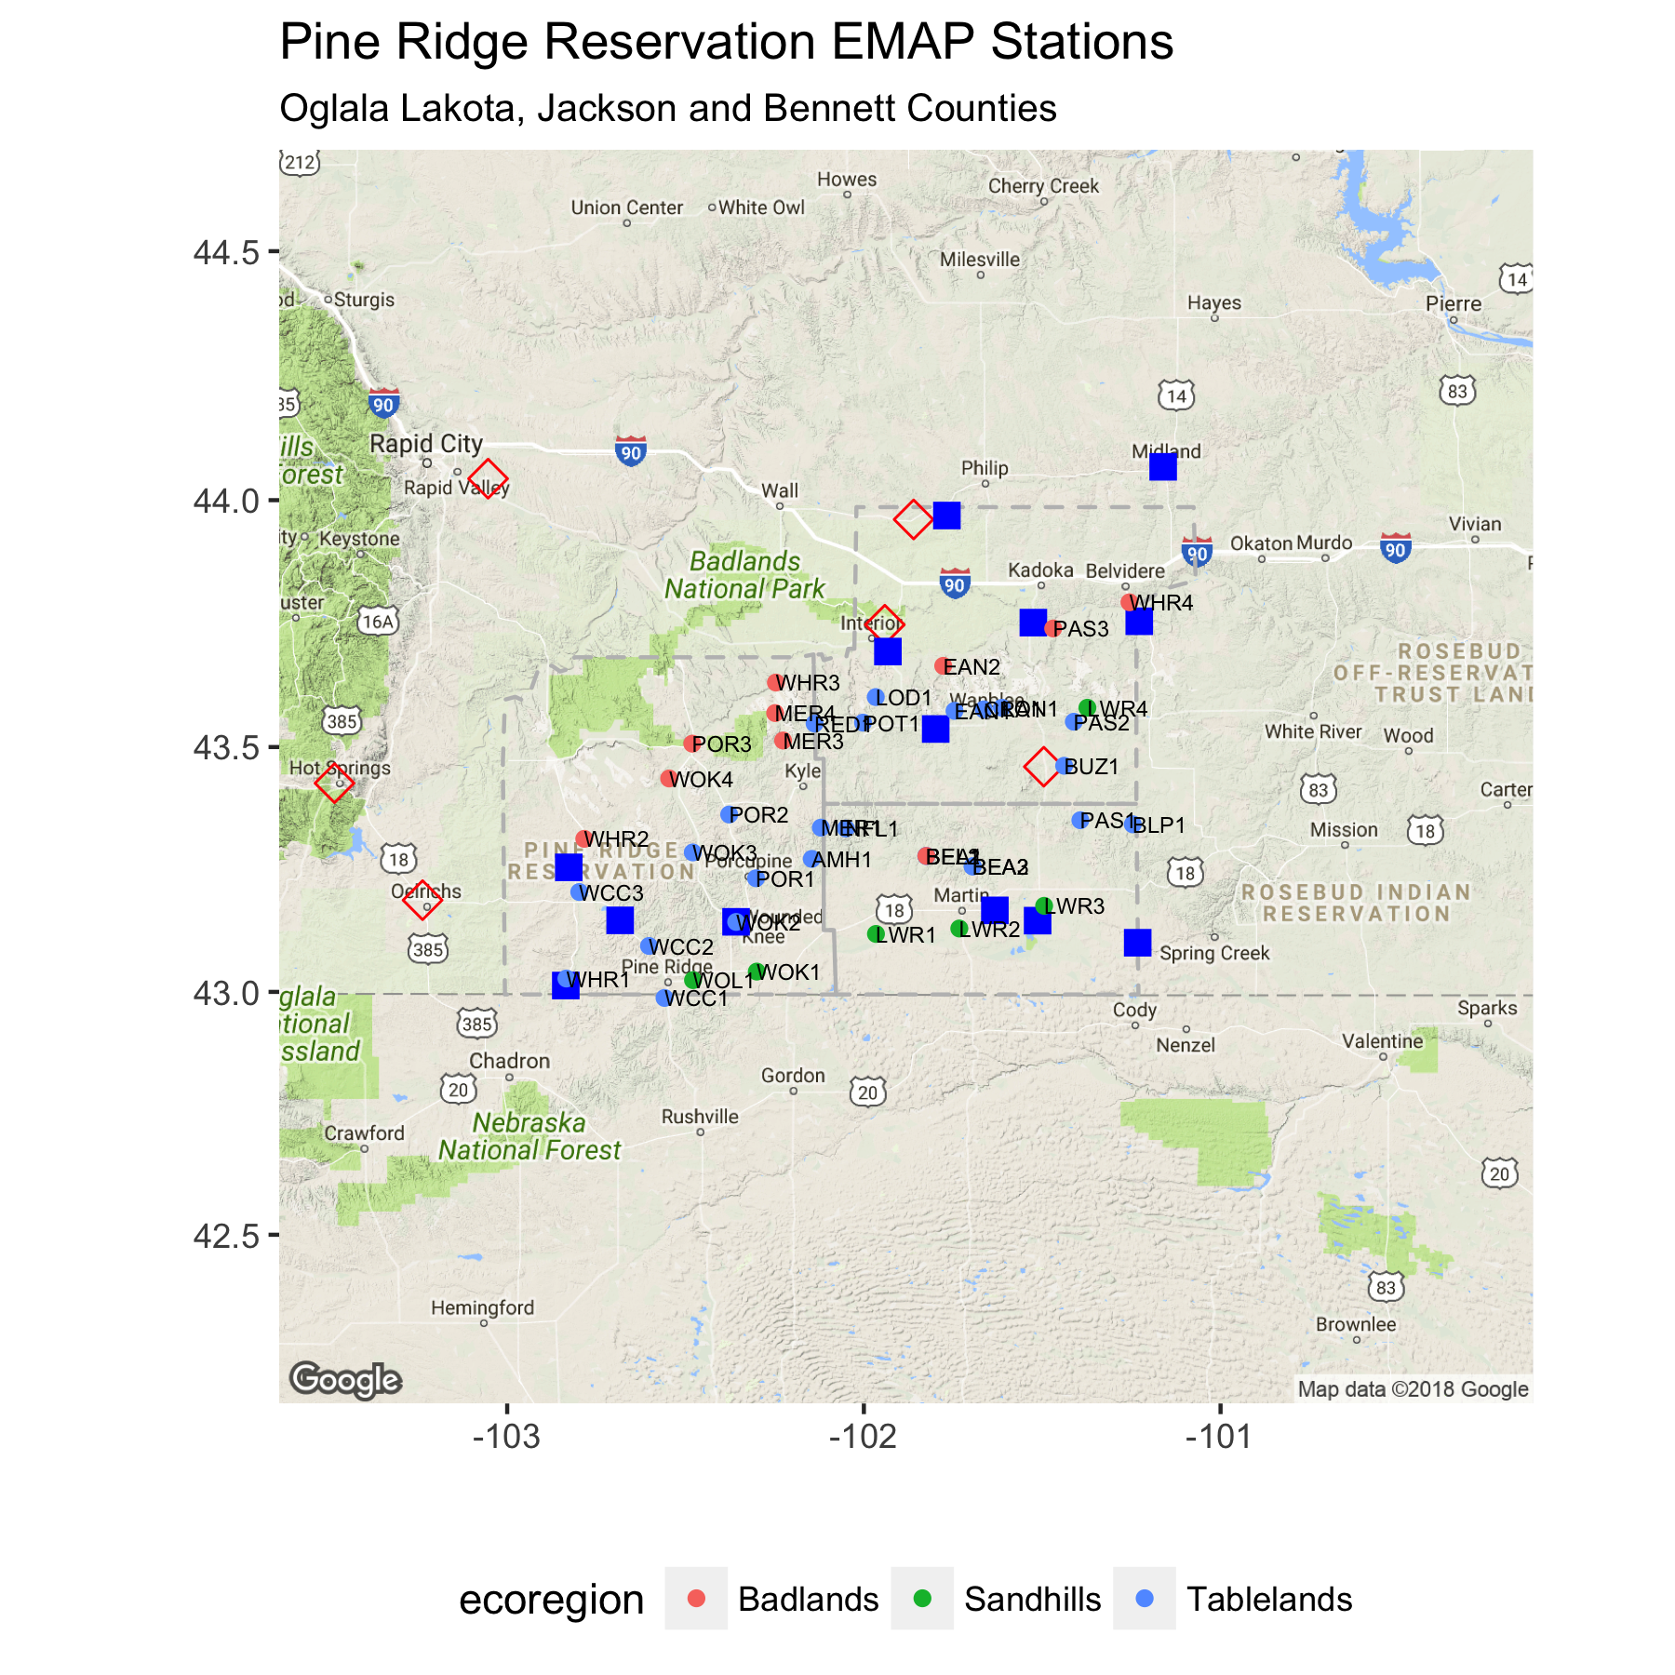
PINE RIDGE Reservation Description
Climate: semi-arid cold mid-latitude steppe (BSk); Precip = 15.8 to 17.2 inches/yr (400 - 450 mm/yr)
Elevation: 2,250 to 3,700 ft (690 - 1,130 m)
Land-cover: Mixed-grass prairie understory with pine savanna on north slopes
Stream-type: Low gradient, dune-ripple morphology streams
Land-use: cattle ranching with minor grass & row crops (N-SE)

Slide 8
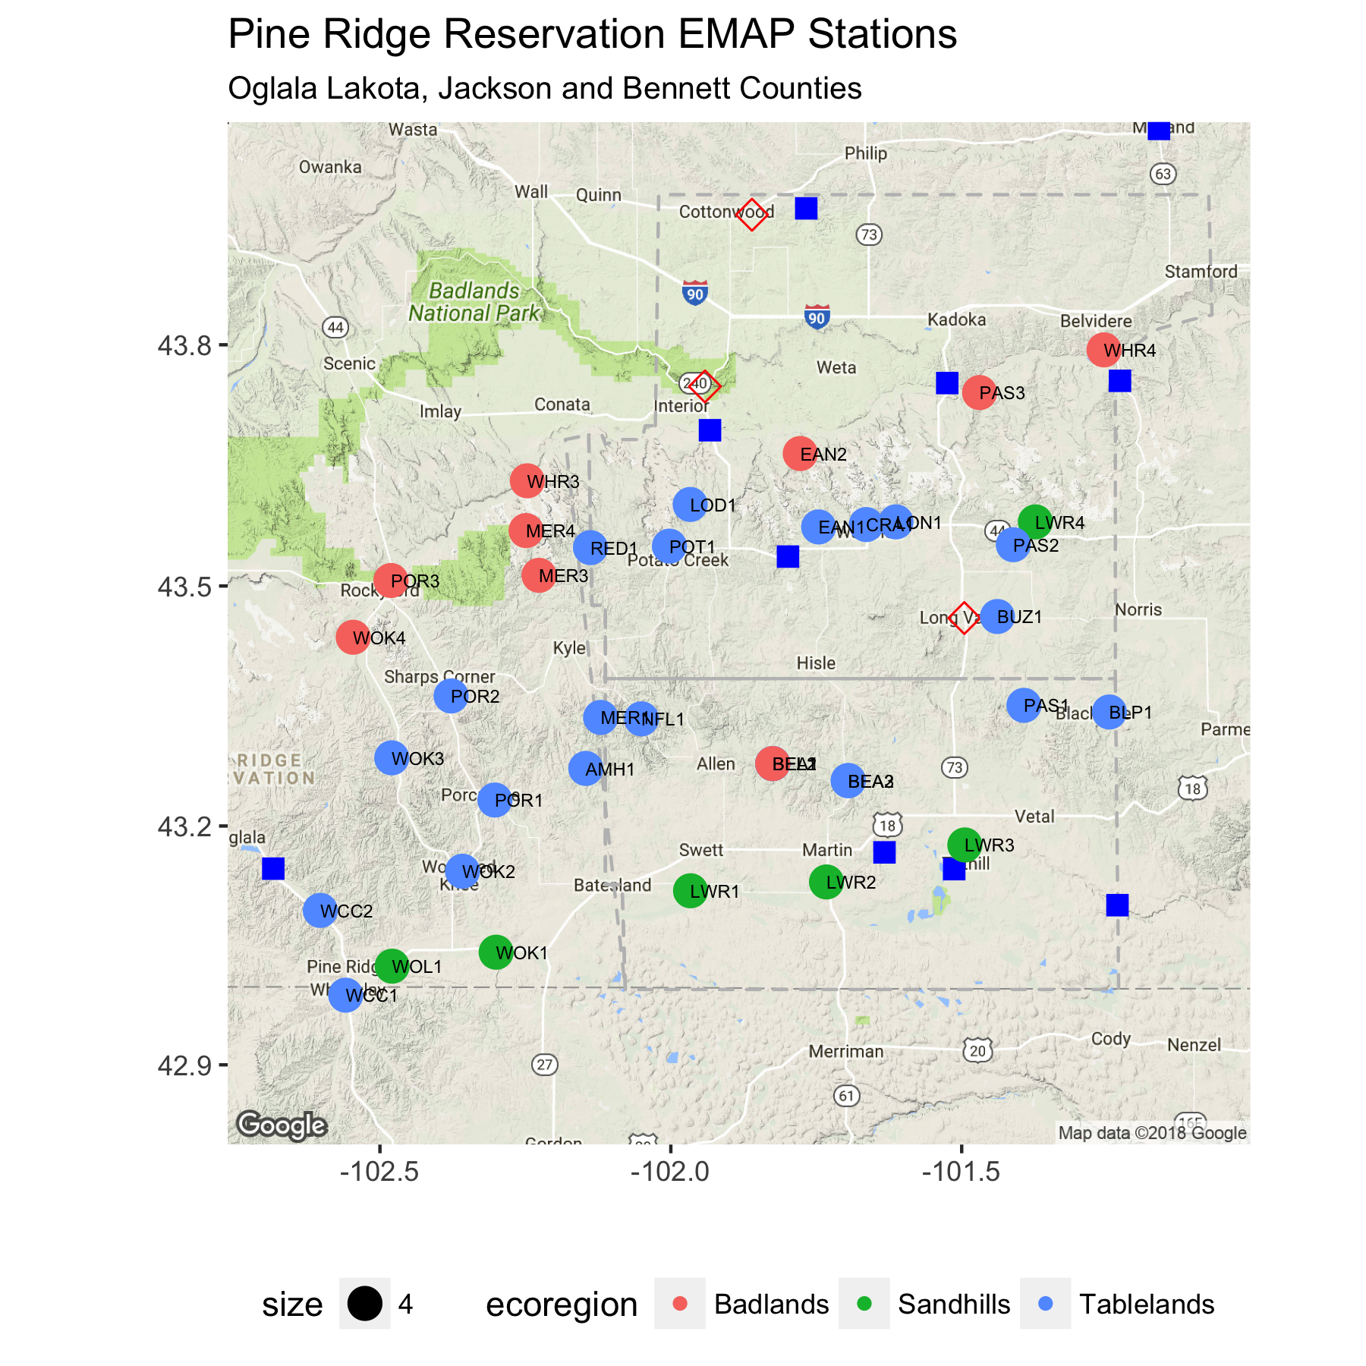
Another Look
Climate: semi-arid cold mid-latitude steppe (BSk); Precip = 15.8 to 17.2 inches/yr (400 - 450 mm/yr)
Elevation: 2,250 to 3,700 ft (690 - 1,130 m)
Land-cover: Mixed-grass prairie understory with pine savanna on north slopes
Stream-type: Low gradient, dune-ripple morphology streams
Land-use: cattle ranching with minor grass & row crops (N-SE)
Lamento que el mapa de hoy tenga muchos pequeños errores

Slide 9

Pine Ridge Reservation has
Heterogeneous Watersheds
Ecoregion & Stratigraphy | Topography | Hydrolologic Regime | Stream bed & water clarity | Floodplain & Riparian zone
Nebraska Sand Hills, QSH | Stabilized sand dunes | Base-flow dominated | Sand, Low turbidity | Well-developed, Little overstay
Keya Paha Tablelands, TA | Soft silty-sandstone plains | Mixed-flow dominated | Silt, Low turbidity | Moderate to well-developed, Ash-elm forest
Pine Ridge Escarpment, TA | Sandstone outcrops |  | Cobbles to silt, Low turbidity
White River Badlands, TWR | Sod tables overlying highly- dissected expansive-clay soils | Event dominated | Silt to clay, High turbidity | Constantly adjusting, Cottonwood-willow woodlands

Slide 10
Pine Ridge Aquatic communitY Shift is correlated with Drought
General Theory
Pine Ridge Reservation
Streamflow varies in time (floods, droughts) & space (climate, geology, flow abstractions)
Pollutants, habitat degradation, and streamflow deficits stress aquatic communities, which are:
Resistant and resilient to pulses (floods)
Resilient to presses (seasonal drought & some pollution).
Exhibit regime shift to ramps (supra-seasonal drought & land use change)
Streamflow changed from normal to high flows in 1990s to dry to low flows in 2000s
PRR streams - generally exhibit high fecal loading, locally exhibit habitat degradation & elevated NO3 & generally respond with:
High biotic integrity (resistance) to 1990s floods
Recover biotic integrity (resilience) following high-intensity grazing pulses
Change from EPT-dominated to non-insect & dipteran-dominated (regime shift) following 2000s drought

Slide 11
But, DOES drought Cause Regime Shift? Are Local Results Generalizable?
General Hypothesis: Drought is a key driver of macroinvertebrate community regime shift for Northern Great Plains streams.
Q1: What are temporal and spatial relationships between meteorological, agricultural, & hydrological drought?
Q2: How does resistance and resilience of taxa common to South Dakota streams compare with taxa resistance and resilience in other published studies?
Q3: Did drought cause the macroinvertebrate community regime shift on the Pine Ridge Reservation?

Slide 12
Q1: What are temporal and spatial relationships between meteorological, agricultural, & hydrological drought?
# | Task | Dataset(s) | Method | Approach | Outcome
1 | Calculate drought indices for weather stations & gages | Monthly precipitation & temperature, mean streamflow | SPI, SPEI & SDI | ‘SPEI’ package for SPI & SPEI New package for SDI index | Transformed time-series at 1-, 3-, 6-, 9-, 12- month scales
2 | Pair weather stations with sites | Geographic coordinates | Theissen polygons | ‘deldir’ package | Precipitation & soil moisture time-series at sites
3 | Cluster gaged watersheds | Mean daily streamflow & watershed area | Determine clustering method & optimal number of clusters | ‘clValid’ package | Compact, well-separated & stable clusters of similar watersheds
 |  |  | Apply clustering method | ‘vegan’ package

Slide 13
Q1: What are temporal and spatial relationships between meteorological, agricultural, & hydrological drought?
# | Task | Dataset(s) | Method | Approach | Outcome
4 | Estimate streamflow deficit for ungauged watersheds | gSSURGO data for SD and Nebraska | Watershed delineation | Hydrology Toolset’ in ArcGIS | Site-level streamflow time-series
 |  |  | Unsupervised classification | ‘randomForest’ package
5 | Characterize drought relationships | Site-level SPI, SPEI, and SDI time series at 3-, 6- 9- and, 12-month scales, hydrologic group membership | Regression | ‘lm’, ‘purrr’, and ‘broom’ packages | Describe associations & model relationships between drought types

Slide 14
Q1: What are temporal and spatial relationships between meteorological, agricultural, & hydrological drought?
# | Task | Dataset(s) | Method | Approach | Outcome
4 | Estimate streamflow deficit for ungauged watersheds | gSSURGO data for SD and Nebraska | Watershed delineation | Hydrology Toolset’ in ArcGIS | Site-level streamflow time-series
 |  |  | Supervised classification | ‘randomForest’ package
5 | Characterize drought relationships | Site-level SPI, SPEI, and SDI time series at 3-, 6- 9- and, 12-month scales, hydrologic group membership | Regression | ‘lm’, ‘purrr’, and ‘broom’ packages | Describe associations & model relationships between drought types

Slide 15
Q2: How does taxa resistance and resilience In South Dakota compare with other published studies?
# | Task | Dataset(s) | Method | Approach | Outcome
1 | Identify resistance, and resilience of common local taxa in PRR streams | Taxa – site matrix | Enumeration | ‘dplyr’, ‘tidyr’, ‘purrr’ packages | Actual likelihoods of taxa being ‘’resistant’, ‘strongly resilient’, ‘weakly resilient’, ’extirpated’
2 | Identify resistance and resilience of common local taxa in other streams | Pdfs of published literature | Text mining | ‘pdfsearch’ package | Expected likelihoods of taxa being ‘’resistant’, ‘strongly resilient’, ‘weakly resilient’, ‘extirpated’
3 | Test for resistance and resilience | Contingency tables of above data | Contingency table analysis | ‘vcd’ & ‘vcdExtra’ packages | Likelihood that a given taxon exhibits resistance & resilience traits

Slide 16
Q3:Does Drought cause macroinvertebrate community regime shift?
# | Task | Dataset(s) | Method | Approach | Outcome
1 | Visualize species compositional patterns | Taxa – site matrix, environmental – site matrix | Non-metric dimensional scaling (NMS) ordination | ‘vegan’ package | Identify major environmental gradients among sites
2 | Compare community structure differences for non-drought, and drought years | Taxa – site matrix, environmental – site matrix | PERMANOVA | ‘vegan’ package | Evaluate drought hypothesis
* Environmental matrix includes SDI index values and water quality data.

Slide 17
Expected RESULTS
Hydrology
Lags in agricultural and hydrologic drought are negatively correlated with lithology with younger units having more porosity
Interesting “outliers” when grouping ungauged watersheds
Ecology
Strong positive correlation between base-flow volume and community resistance
Recovery to a pre-drought composition within one-year of a seasonal drought
Regime shift to smaller-bodied & r-selected taxa & more gastropods following a supra seasonal drought

Slide 18
Expected Outputs
Literature review - background to set context for study – published as a state of the science article for competing drought definitions and relationship of these to data sources - may include ecological drought and IBI index approach
Methods / application paper on the use of drought indices to characterize hydrology of geologically complex region - how to interpret the different drought indices for a specific geographic region so not a state of the science article but one that focuses on the application of the drought indices and the data that exists for the region.)
Taxa drought resilience - focus on the identified taxa for the geographic region identified as being drought resistant or resilient and how the identified types compare to those identified in the literature as being drought resistant or resilient
Abiotic drivers of taxa regime changes - expand on the previous article by linking the changes seen in Taxa to the identified drivers that precede the changes
Use ‘thesisdown’ to create dissertation template in R Studio https://github.com/ismayc/thesisdown (mostly complete)
All analysis / data is repeatable using GitHub pull requests https://github.com/cjtinant
Three to four co-authored papers following the test of a committee member "providing substantial feedback on the development of a paper”

Slide 19
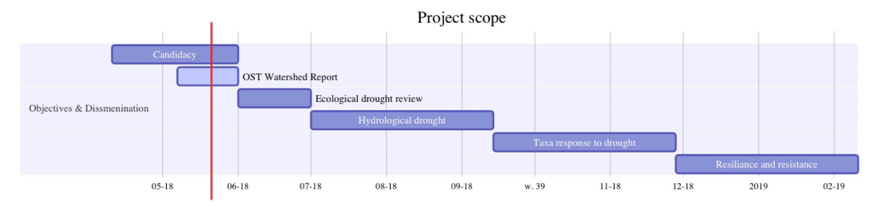
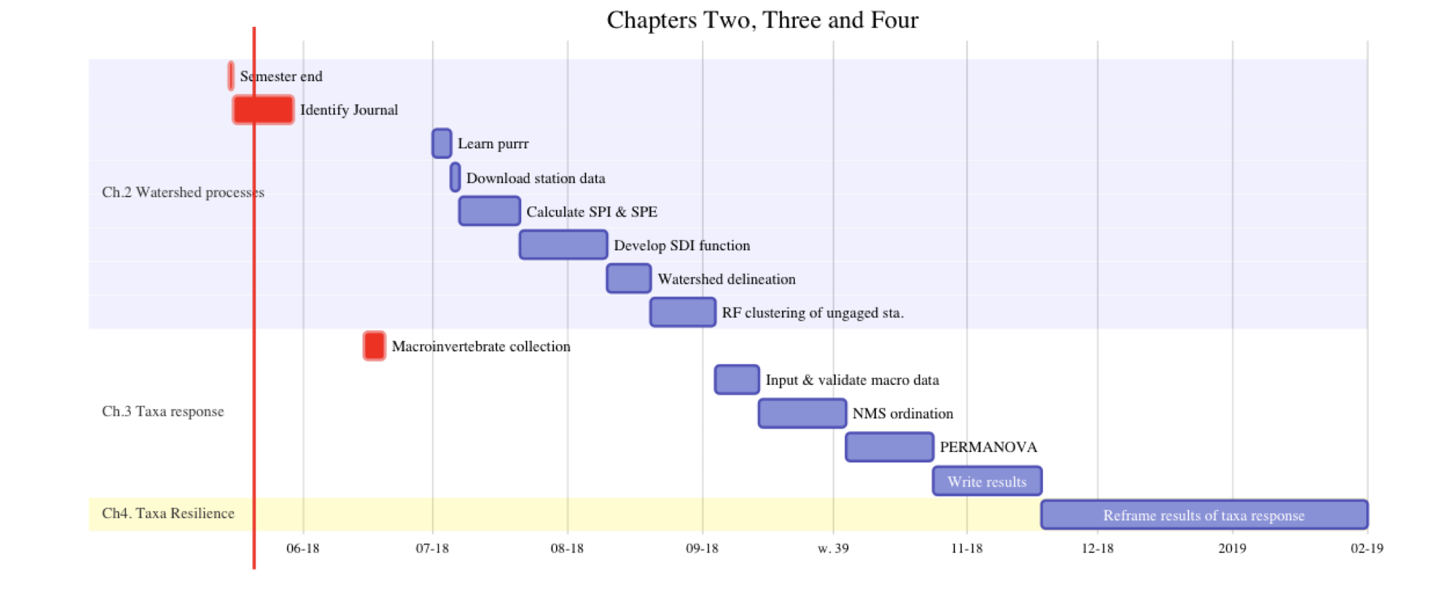
Timeline

Slide 20
Next STEPS -> one of several: How do Pine Ridge Reservation Results compare with other dryland studies?
# | Task | Dataset(s) | Method | Approach | Outcome
1 | Define seasonal vs. supra seasonal drought | Literature | Expert opinion | NA | Quantify drought types
2 | Prepare meta-analysis | Monthly precip. & temp., geographic coordinates, taxa data | Email, telephone | NA | Data for meta-analysis
3 | Visualize species compositional patterns | Taxa – site matrix, environmental – site matrix | Non-metric dimensional scaling (NMS) ordination | ‘vegan’ package | Identify major environmental gradients among sites
4 | Compare community structure differences for non-drought, and drought years | Taxa – site matrix, environmental – site matrix | PERMANOVA | ‘vegan’ package | Evaluate drought hypothesis
* Environmental site index includes SPEI values, elevation, & geographic coordinates

Slide 21
This is the part where I listen to sage advice
For the title -> Ecological response to drought for Northern Great Plains Streams
Timeline -> good target - somewhat aggressive, but space for rescaleing (concerns about scope) - more maps - show a map of the area
Proposal had methods (maybe extraneous),
Questions are unclear: What are you doing???
Peter Nelson -> Overall
Concerns -> about how these
Clarify that streamflow is a proxy for geology, drought
Is it just drought? Or does physiography play a role? YES. Describe this more clearly
How far the observation stations from areas of study?
Space -> interpolate the weather data… Krieging? Or PRISM data? Climate NA? Select the data???
Depositional environment - Nitogen load.
ANALYSIS Sequence Flow Chart (Change the tables to pictures)
E

